Slide 1

HACK-O-HIRE-2026
Cyber Incident Response in Banking
Problem Statement :
Build an autonomous cyber incident response tool utilizing AI

Slide 2
HACK-O-HIRE-2026
Mksss’s Cummins College Of Engineering For Women,Pune.
Team Name: TechByte
Member 1: Shalaka Parhad
Member 2: Akshita Paliwal
Member 3: Mansi Sawarkar
Member 4: Vanshika Agrawal
Member 5: Nidhi Patil

Slide 3
Abstract
HACK-O-HIRE-2026
Modern security teams face a flood of alerts that lack context and need a lot of manual investigation. Our AI-powered Autonomous Incident Response System detects, understands, scores, and responds to threats intelligently.
It gathers security data from SIEM, EDR, firewalls, and authentication logs. Then, it normalizes logs, removes duplicates, and cuts down on noise through clustering and lightweight anomaly detection. Events are linked across systems to create structured incidents. Behavioral analytics (UEBA) and threat graph modeling evaluate unusual activity, lateral movement, and asset importance.
Each incident is assessed using a Fidelity Score and a Risk Score. These scores are combined into a Severity Classification that guides the Decision Engine. Low-severity incidents are automated, medium ones need SOC approval, and high or critical incidents are escalated manually. The system reconstructs attack timelines, creates contextual playbooks, and performs safe, reversible actions.
A blockchain based tamper-proof audit layer maintains forensic integrity. Meanwhile, SOC and executive dashboards provide operational and strategic insights, such as risk breakdown, blast radius visualization, and automation metrics. The system allows for efficient, clear, and compliant incident response.

Slide 4
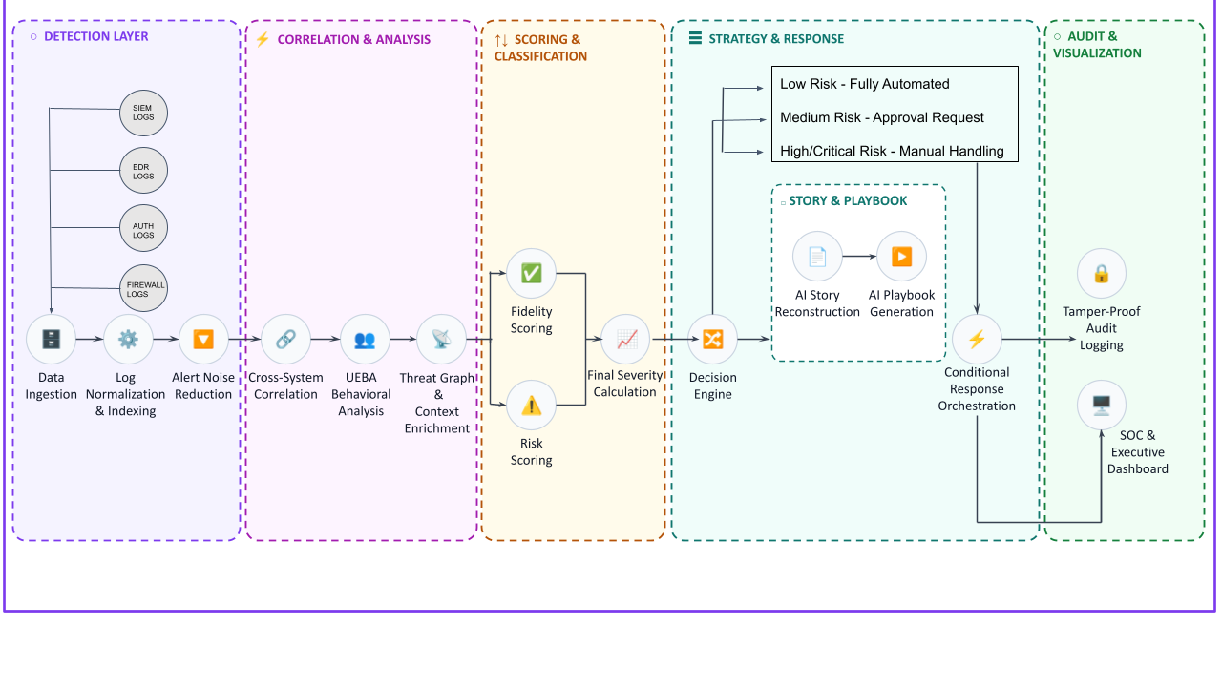
System Architecture
HACK-O-HIRE-2026

Slide 5
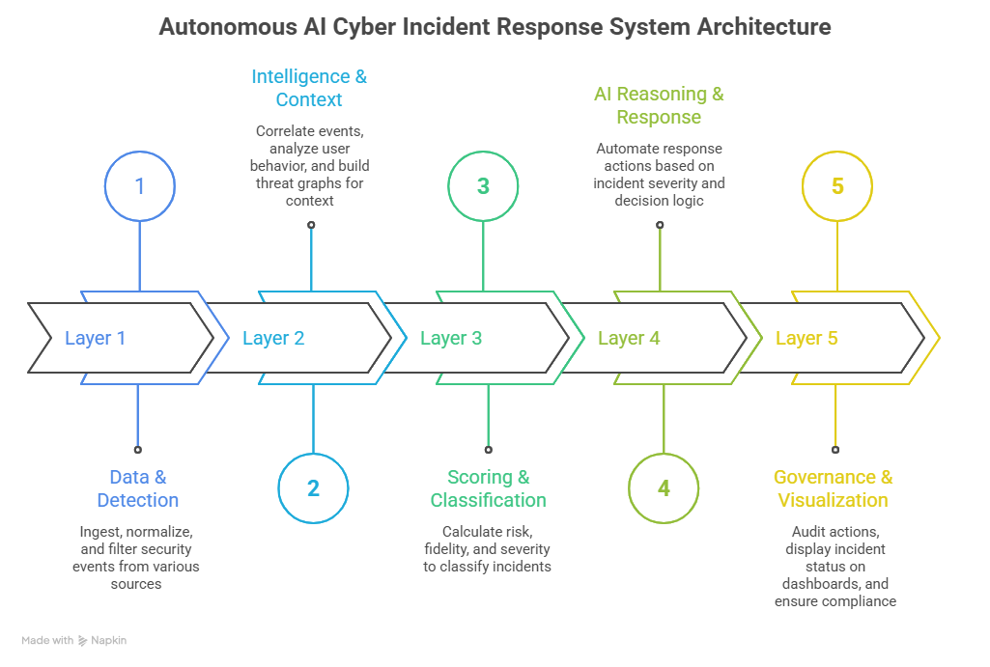
Methodology
HACK-O-HIRE-2026

Slide 6
HACK-O-HIRE-2026
Layers
Performance
Scalability
High throughput,real-time ingestion
Efficient normalisation & alert filtering
Reduces alert noise significantly
Data and Detection
Horizontal: add nodes for more logs
Vertical: scale CPU/RAM per node
Intelligence & Context
Fast correlation and pattern detection
Real-time UEBA scoring
Threat graph queries optimized
Horizontal: process multiple incidents in parallel
Graph DB supports clustering/sharding
Scoring &
Classification
Near-instant scoring and severity calculation
Minimal processing overhead
Horizontal: multiple scoring engines
Vertical: CPU scaling optional
Efficient story reconstruction & playbook generation
Conditional execution of actions
Horizontal: Multiple response engines / automation workers
Queue-based execution for concurrent actions
AI Reasoning and
Response
Real-time dashboard visualization
Supports large number of concurrent incidents
Horizontal: Add dashboard nodes / shards
Vertical: Increase memory for query caching
Governance &
Visualisation

Slide 7
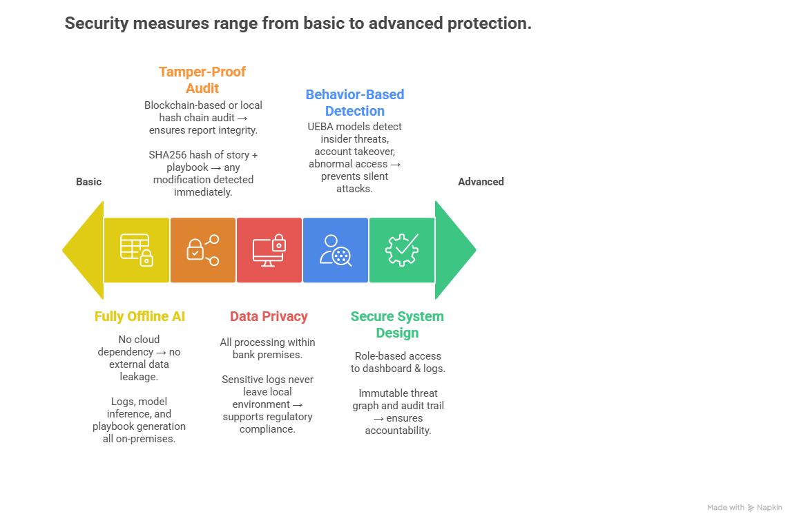
Security
HACK-O-HIRE-2026

Slide 8



















Technology Stack
HACK-O-HIRE-2026
Layers
Technologies Used
Purpose
React.js
Tailwind CSS
SOC analyst dashboard, executive risk view, severity visualization, blast radius graphs.
Frontend
Chart.js
D3.js
Python
FastAPI (REST APIs)
Core processing, orchestration, decision engine, policy control, API services.
Backend
Elasticsearch Python Client
JWT Authentication (RBAC)
PyOD
tsfresh
ML models
Noise reduction, UEBA behavioral analysis, threat graph modeling, fidelity & risk scoring.
AI & ML
Pytorch
NetworkX
AI reasoning and LLM
LangChain
Ollama
Incident story reconstruction, attack timeline explanation, AI playbook generation.
Huggingface Transformers
Blockchain & Security
Tamper-proof audit logs, integrity verification, access control, compliance.
Hyperlegder Fabric,SHA-256 hashing
Visualisation & Monitoring
To show incidents clearly using simple graphs.
Matplotlib
Plotly

Slide 9
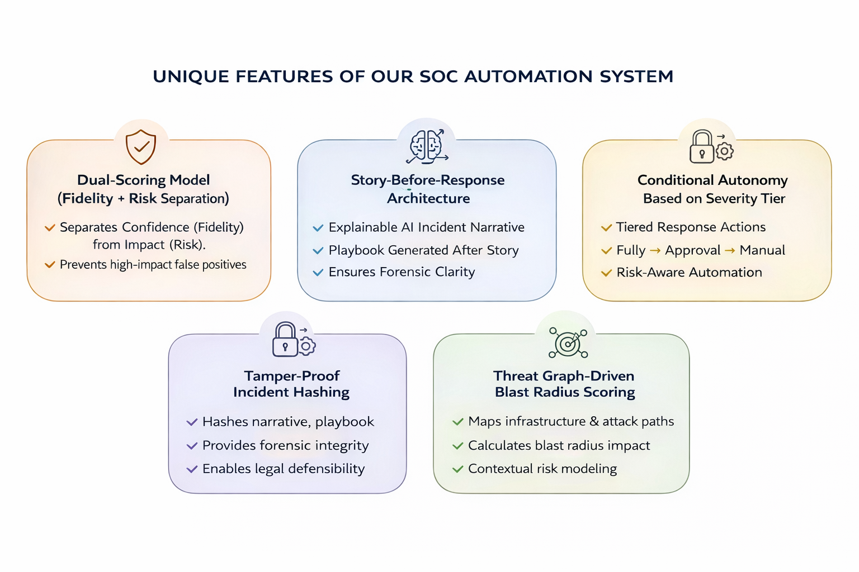
Unique Features
HACK-O-HIRE-2026

Slide 10
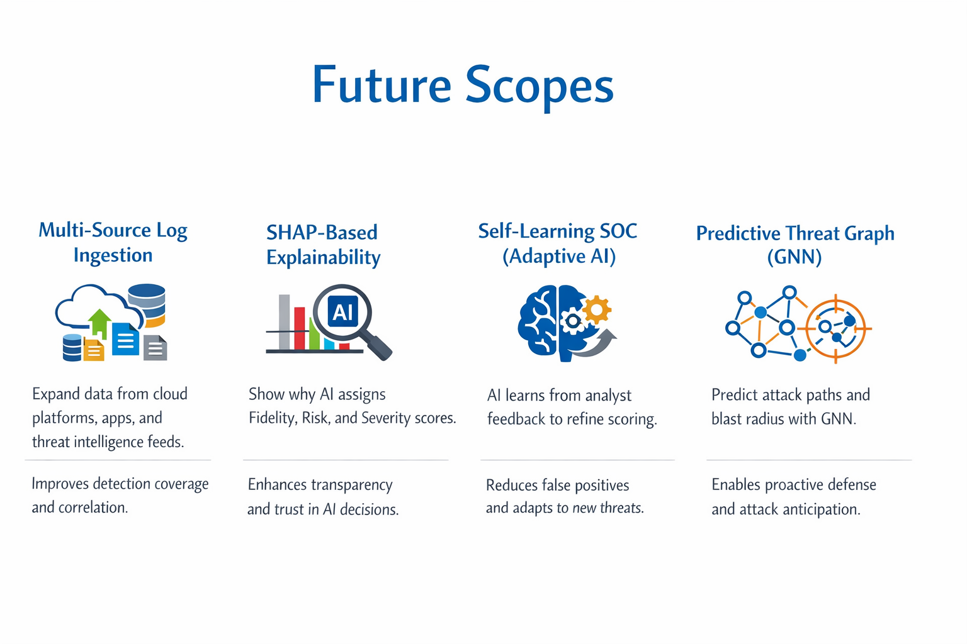
Future Scope
HACK-O-HIRE-2026

Slide 11
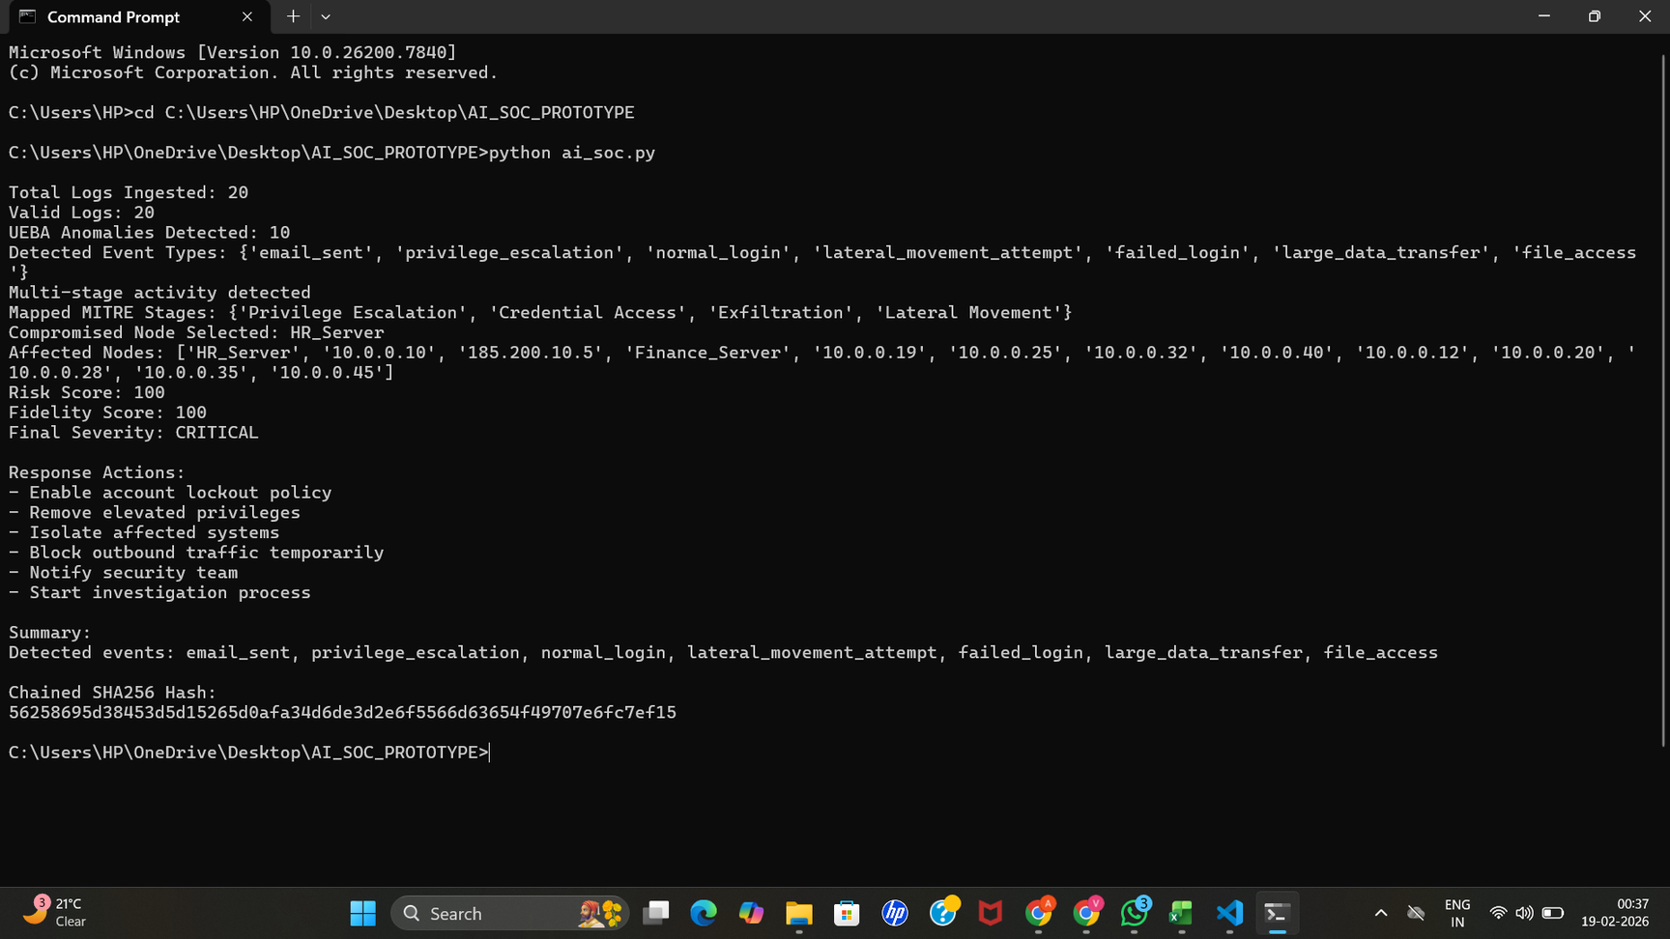
Prototype Output: AI-Driven Incident Detection & Response
HACK-O-HIRE-2026

Slide 12
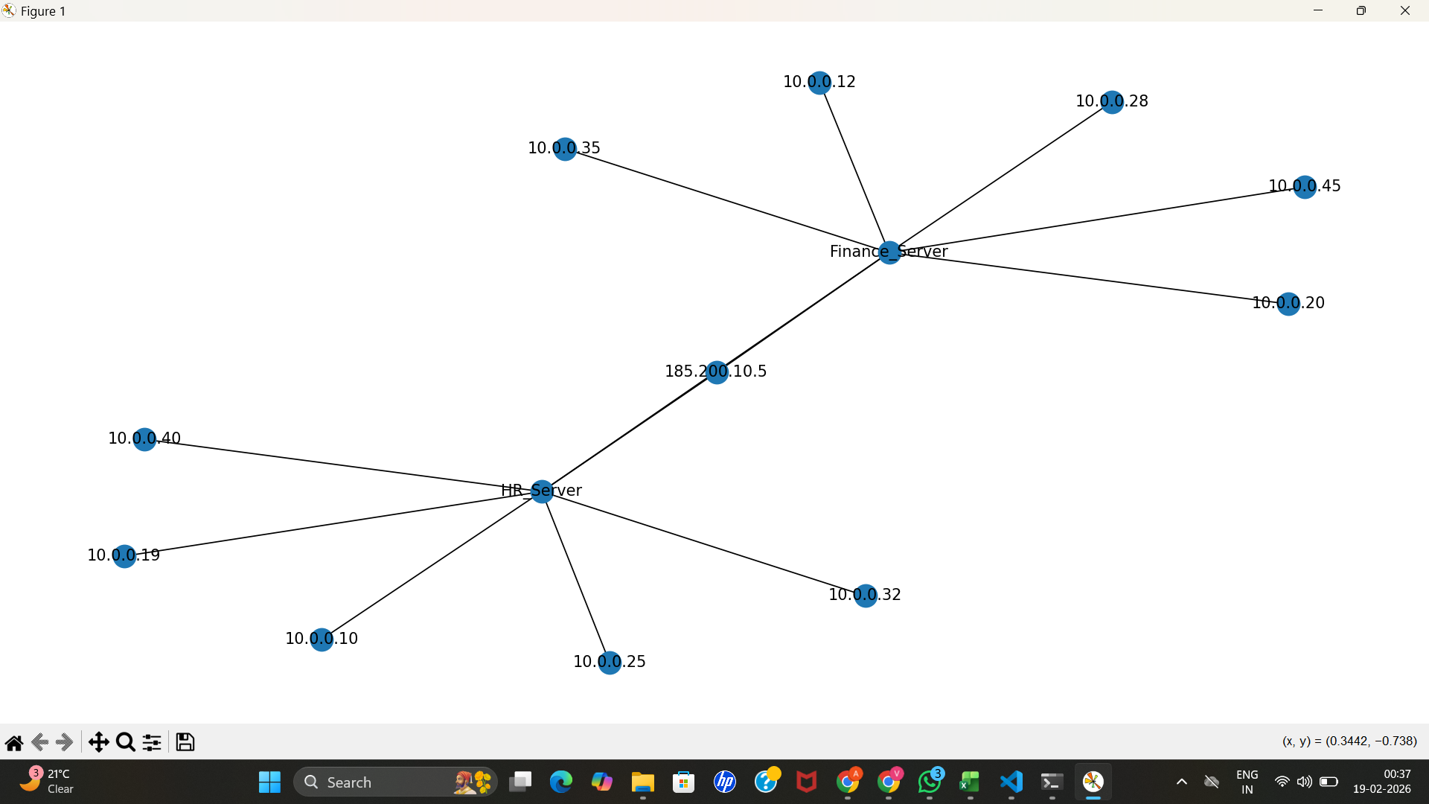
Prototype Output: Threat Graph & Attack Path Visualization
HACK-O-HIRE-2026

Slide 13
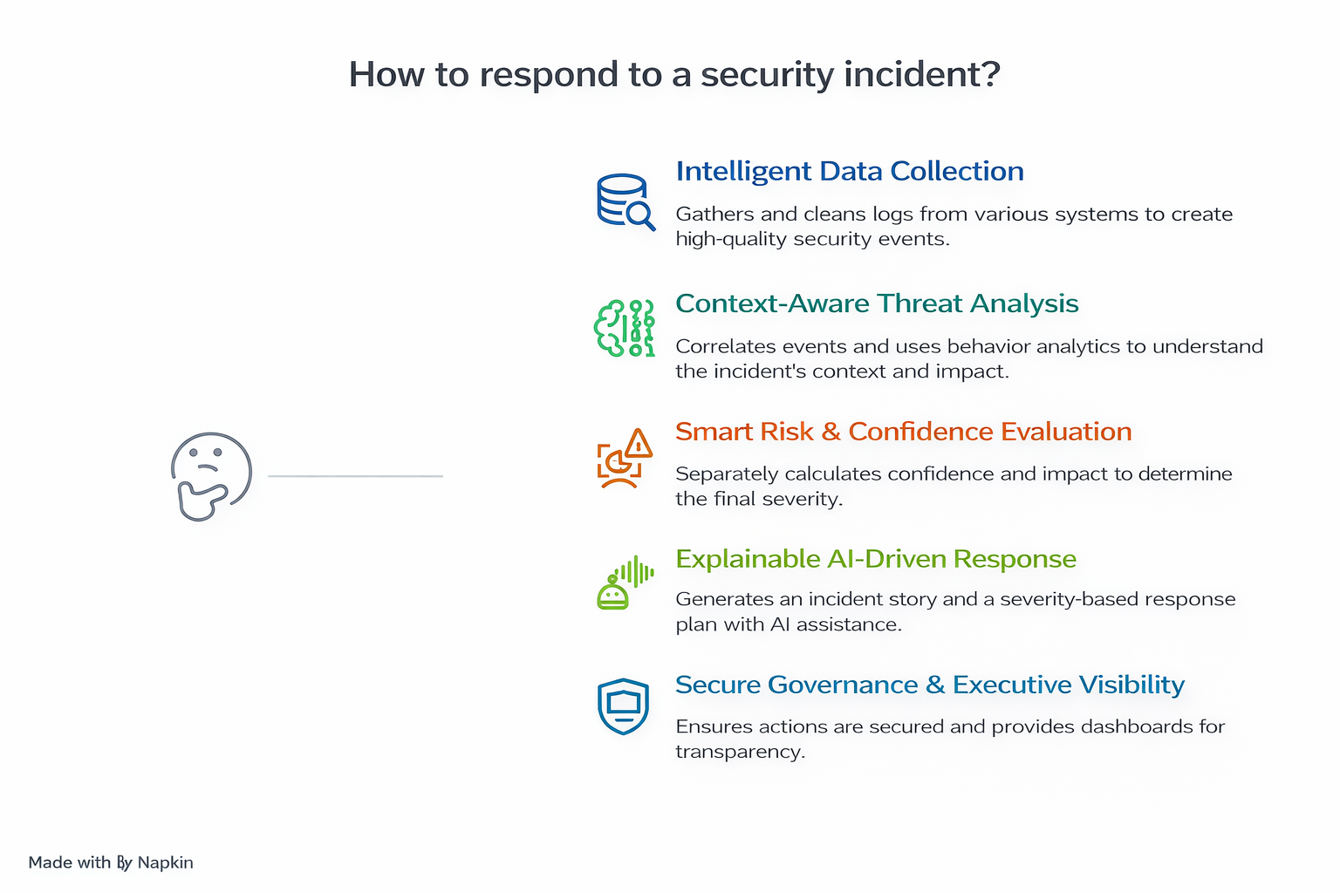
Solution Overview
HACK-O-HIRE-2026

Slide 14
HACK-O-HIRE-2026
Prototype Link →
GitHub Repository
THANK YOU!
“Turning complex threats into clear, actionable responses.”

